Slide 1
Managerial Environment
Session 6
19th May, 2026

Slide 2
External Environment

Slide 3
Relationship between an Organization and its Environment
What Is the Environment?
For any organization, the environment consists of the set of external conditions and forces that have the potential to influence the organization
Example: Customers, Rivals, Society, Politics
It is useful to break the concept of the competitive environment for a business down into two components: the general environment and its industry.
The general environment, or macro-environment, includes overall trends and events in society such as social trends, technological trends, demographics, and economic conditions.
The industry, or competitive environment, consists of multiple organizations that collectively compete with one another by providing similar goods, services, or both.

Slide 4
Why Does the Environment Matter?
First, the environment provides resources that an organization needs in order to create goods and services.
Second, the environment is a source of opportunities and threats for an organization. Opportunities are events and trends that create chances to improve an organization’s performance level. Threats are events and trends that may undermine an organization’s performance
Third, the environment shapes the various strategic decisions that executives make as they attempt to lead their organizations to success. The environment often places important constraints on an organization’s goals, for example.

Slide 5
Evaluating the General Environment
The Elements of the General Environment: PESTEL Analysis
PESTEL analysis is one important tool that executives can rely on to organize factors within the general environment and to identify how these factors influence industries and the firms within them.
PESTEL reflects the names of the six segments of the general environment: (1) political, (2) economic, (3) socio-cultural, (4) technological, (5) environmental, and (6) legal.

Slide 6
PESTEL framework
P | Political factors include elements such as tax policies, changes in trade restrictions and tariffs, and the stability of governments.
E | Economic factors include elements such as interest rates, inflation rates, gross domestic product, unemployment rates, levels of disposable income, and the general growth or decline of the economy.
S | Socio-cultural factors include trends in demographics such as population size, age, and ethnic mix, as well as cultural trends such as attitudes toward obesity and consumer activism.
T | Technological factors include, for example, changes in the rate of new product development, increases in automation, and advancements in service industry delivery.
E | Environmental factors, also called ecological factors, include, for example, natural disasters, global warming, pollution, and weather patterns.
L | Legal factors include laws involving issues such as employment, health and safety, discrimination, and antitrust.

Slide 7
Evaluating the Industry

Slide 8
The Purpose of Five Forces Analysis (Porter)
Threat of potential entrants are firms that are not currently considered viable competitors in the industry but that may become viable competitors in the future.
Bargaining power of suppliers
Rivalry of industry competitors
Bargaining power of buyers are those firms that buy directly from the industry
Threat of substitutes

Slide 9
The purpose of Five Forces Analysis is to identify how much profit potential exists in an industry.
To do so, Five Forces Analysis considers the interactions among the competitors in an industry, potential new entrants to the industry, substitutes for the industry’s offerings, suppliers to the industry, and the industry’s buyers (Porter, 1979).
If none of these five forces works to undermine profits in the industry, then the profit potential is very strong.
If all the forces work to undermine profits, then the profit potential is very weak.
Most industries lie somewhere in between these extremes.

Slide 10
The Rivalry among Competitors in an Industry
The competitors in an industry are firms that produce similar products or services.
Competitors use a variety of moves such as advertising, new offerings, and price cuts to try to outmaneuver one another to retain existing buyers and to attract new ones.
Because competitors seek to serve the same general set of buyers, rivalry can become intense

Slide 11
Rivalry among existing competitors tends to be high to the extent that…
Competitors are numerous or are roughly equal in size and power. | No one firm rules the industry, and cutthroat moves are likely as firms jockey for position.
The growth rate of the industry is slow. | A shortage of new customers leads firms to steal each other’s customers.
Competitors are not differentiated from each other. | This forces firms to compete based on price rather than based on the uniqueness of their offerings
Fixed costs in the industry are high. | These costs must be covered, even if it means slashing prices in order to do so.
Exit barriers are high. | Firms must stay and fight rather than leaving the industry gracefully.
Excess capacity exists in the industry. | When too much of a product is available, firms must work hard to earn sales.
Capacity must be expanded in large increments to be efficient. | The high costs of adding these increments needs to be covered.
The product is perishable | Firms need to sell their wares before they spoil and become worthless.

Slide 12
Industry Concentration
Industry concentration refers to the extent to which large firms dominate an industry.
Buyers and suppliers generally have more bargaining power when they are from concentrated industries.
This is because the firms that do business with them have fewer options when seeking buyers and suppliers.

Slide 13
Industry Concentration
High-Concentration Industries | Circuses (89%) and breakfast cereal manufacturing (85%)
Medium-Concentration Industries | Flight training (52%) and sugar manufacturing (60%)
Low-Concentration or “Fragmented” Industries | Full-service restaurants (9%), Legal services (3%), Truck driving schools (27%), and Telephone call centers (22%)

Slide 14
Threat of new entrants
Economies of scale | As the number of customers a firm serves increases, the cost of serving each customer tends to decrease. This is because fixed costs—the expenses the firm must pay—are allocated across a larger number of sales. When the firms in an industry enjoy significant economies of scale, new firms struggle to be able to sell their wares at competitive prices.
Capital requirements | The more expensive it is to enter a business, the less likely a new firm is to attempt to enter it.
Access to distribution channels | The ability to get goods and services to customers can pose a significant challenge to would-be newcomers
Government policy | Decisions made by governments can deter or encourage potential new entrants.
Differentiation | Highlighting the unique features of the products
Switching costs | Costs incurred to change the product/service
Expected retaliation | New firms entering a industry might face responses from the other players, say by reducing prices or offering incentives
Cost advantages independent of size | Proprietary technology, access to raw materials, and desirable geographic location are all examples of cost advantages not directly associated with size and economies of scale

Slide 15
Power of Suppliers
A supplier group is powerful if it is dominated by a few companies or is more concentrated than the industry that it supplies.
A supplier group is powerful if there is no substitute for what the supplier group provides.
A supplier group is powerful if industry members rely heavily on suppliers to be profitable.
A supplier group is powerful if industry members face high costs when changing suppliers.
A supplier group is powerful if their products are differentiated.
A supplier group is powerful if it can credibly threaten to compete (integrate forward) in the industry if motivated.

Slide 16
Bargaining power of Buyers
A buyer group is powerful when there are relatively few buyers compared to the number of firms supplying the industry.
A buyer group is powerful when the industry’s goods or services are standardized or undifferentiated.
A buyer group is powerful when they face little or no switching costs in changing vendors.
A buyer group is powerful when the good or service purchased by the buyers represents a high percentage of the buyer’s costs, encouraging ongoing searches for lower-priced suppliers.
A buyer group is powerful if it can credibly threaten to compete (integrate backward) in the industry if motivated.
A buyer group is powerful when the good or service purchased by buyer groups is of limited importance to the quality or price of the buyer’s offerings.

Slide 17
Strategic Groups
Strategic groups are sets of firms that follow similar strategies to one another (Hunt, 1972; Short et al., 2007).
A strategic group consists of a set of industry competitors that have similar characteristics to one another but differ in important ways from the members of other groups

Slide 18
Internal Environment

Slide 19
Managing Firm Resources: Resource-based view
According to resource-based theory, organizations that own “strategic resources” have important competitive advantages over organizations that do not.
Some resources, such as cash and trucks, are not considered to be strategic resources because an organization’s competitors can readily acquire them.
Instead, a resource is strategic to the extent that it is valuable, rare, difficult to imitate, and organized to capture value

Slide 20
Resource-Based View: The Basics
VALUABLE resources aid in improving the organization’s effectiveness and efficiency while neutralizing the opportunities and threats of competitors.
RARE resources are those held by few or no other competitors.
DIFFICULT-TO-IMITATE resources often involve legally protected intellectual property such as trademarks, patents, or copyrights. Other difficult-to-imitate resources, such as brand names, usually need time to develop fully.
ORGANIZED TO CAPTURE VALUE: Having in place the organizational systems, processes, and structure to capitalize on the potential of the resources and capabilities of the firm to provide a competitive advantage.

Slide 21
Resources and capabilities are the basic building blocks that organizations use to create strategies. These two building blocks are tightly linked—capabilities from using resources over time.
Resources can be divided into two main types: tangible and intangible.
Tangible resources are resources that can be readily seen, touched, and quantified. Physical assets such as a firm’s property, plant, and equipment are considered to be tangible resources, as is cash.
Intangible resources are quite difficult to see, touch, or quantify. Intangible resources include, for example, the knowledge and skills of employees, a firm’s reputation, and a firm’s culture
While resources refer to what an organization owns, capabilities refer to what the organization can do.
Capabilities refer to the firm’s ability to bundle, manage, or otherwise exploit resources in a manner that provides added value and, hopefully, advantage over competitors.

Slide 22
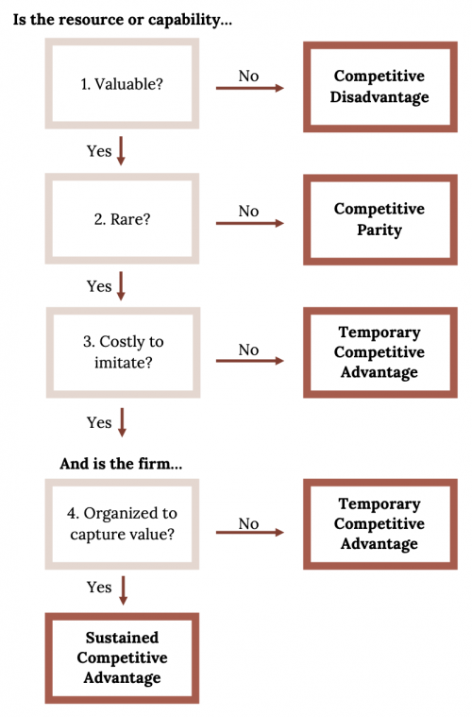
VRIO: Four Characteristics of Strategic Resources

Slide 23
A strategic resource is an asset that is valuable, rare, difficult to imitate, and organized to capture value (Barney, 1991; Chi, 1994).
A resource is valuable to the extent that it helps a firm create strategies that capitalize on opportunities and ward off threats.
Competitors have a hard time duplicating resources that are difficult to imitate.
Some difficult to imitate resources are protected by various legal means, including trademarks, patents, and copyrights.
Other resources are hard to copy because they evolve over time and they reflect unique aspects of the firm
A resource is organized to capture value when the firm has organizational systems, processes, and structure in place to capitalize on the resource for a competitive advantage.

Slide 24
Intellectual Property and Isolating Mechanisms
Intellectual property refers to creations of the mind, such as inventions, artistic products, and symbols.
The four main types of intellectual property are patents, trademarks, copyrights, and trade secrets

Slide 25
Types of Intellectual Property
Patents protect inventions from direct imitation for a limited period of time.
Trademarks are phrases, pictures, names, or symbols used to identify a particular organization
Copyrights provide exclusive rights to the creators of original artistic works such as books, movies, songs, and screenplays. Sometimes copyrights are sold and licensed.
Trade secrets refer to formulas, practices, and designs that are central to a firm’s business and that remain unknown to competitors

Slide 26
Isolating Mechanisms
If a firm can prevent a competitor from imitating the resource or capability that gives it a competitive advantage, it is able to sustain that advantage longer. This strategy is called isolating mechanisms.
A patent, for example, is a legal way to prevent imitation.

Slide 27
Kinds of isolating mechanisms
Social Complexity: The interrelationships within a firm, along with relationships within or across a business process, can be difficult to imitate.
For example, key relationships that members of a firm have with a supplier of a key strategic resource create a condition that a competitor cannot duplicate.
This social complexity creates a barrier to imitation and can prolong a competitive advantage possessed by an organization.
Social complexity might arise through certain customer relationships or with key political figures, provided they can help the firm’s competitive position

Slide 28
Kinds of isolating mechanisms
Path Dependence: The path that a firm takes over time to achieve the point of a competitive advantage may also provide a barrier to imitation.
Decisions made in the past that brought a firm to its current position may make it very difficult for other firms to imitate.
The accumulated learning and experience gained along the historical path are not easily duplicated.
This path dependence can serve as an isolating mechanism to block competitors from gaining the same position in the market.

Slide 29
Kinds of isolating mechanisms
Causal Ambiguity: It means the reason for achieving a competitive advantage is not apparent.
The cause for success is obscure and not understood well.
Because the firm itself does not really know why it has achieved success, it is quite difficult for a competitor to replicate it.

Slide 30
Value Chain
A value chain charts the path by which products and services are created and eventually sold to customers (Porter, 1985).
The term value chain reflects the fact that, as each step of this path is completed, the product becomes more valuable than it was at the previous step

Slide 31
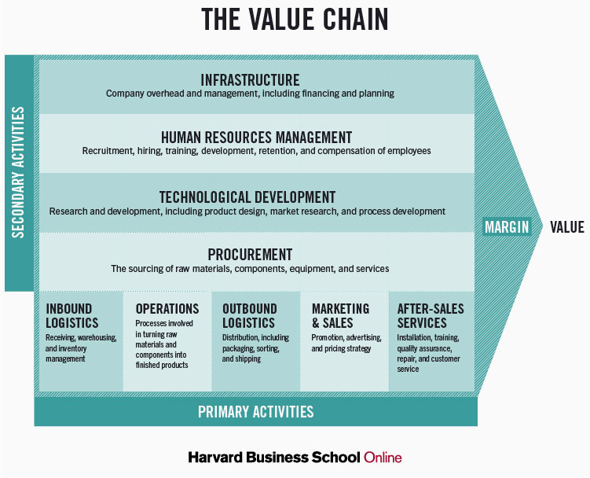

Slide 32
Value Chain
Value chains include both primary and secondary activities.
Primary activities are actions that are directly involved in creating and distributing goods and services.
Secondary activities are not directly involved in the evolution of a product, but instead provide important underlying support for primary activities

Slide 33
Types of Primary Activities
Inbound logistics refers to the arrival of raw materials
Operations refers to the actual production process
Outbound logistics tracks the movement of a finished product to customers
Marketing and sales: Attracting potential customers and convincing them to make purchases
Service refers to the extent to which a firm provides assistance to their customers

Slide 34
Types of Secondary Activities
Firm infrastructure refers to how the firm is organized and led by executives.
Human resource management involves the recruitment, training, and compensation of employees
Technology refers to the use of computerization and telecommunications to support primary activities
Procurement is the process of negotiating for and purchasing raw materials

Slide 35
SWOT Framework
Strengths and weaknesses are assessed by examining the firm, while opportunities and threats refer to external events and trends

Slide 36
Selecting business-level strategies
A generic, business-level strategy is also called its generic competitive strategy, because it defines how a firm competes head-to-head against similar products and services in the marketplace.
According to Michael Porter, a firm may pursue one of five generic/competitive business-level strategies: broad cost leadership, broad differentiation, focused cost leadership, focused differentiation, and best cost strategies

Slide 37
According to Porter, two competitive dimensions are the keys to business-level strategy.
The first dimension is a firm’s source of competitive advantage. This dimension involves whether a firm tries to gain an edge on rivals by keeping costs down or by offering something unique in the market.
The second dimension is a firms’ scope of operations. This dimension involves whether a firm tries to target customers in general or whether it seeks to attract just a narrow segment of customers.

Slide 38
Business-Level Strategies
Competitive Advantage: Cost
Broad Target Market: cost leadership strategy depends on attracting a large customer base and keeping prices low by buying massive quantities of goods from suppliers
Narrow Target Market: Company does not offer a full array of consumer goods, but those that it does offer are priced to move.
Competitive Advantage: Differentiation
Broad Target Market: Organization builds its differentiation strategy around offering designer merchandise and providing exceptional service.
Narrow Target Market: Company follows a focused differentiation strategy by selling unique (and pricey) products

Slide 39
Cost leadership
Firms that compete based on price and target a broad target market are following a broad cost leadership strategy.
A firm following a cost leadership strategy offers products or services with acceptable quality and features to a broad set of customers at a low price

Slide 40
Executing a Low-Cost Strategy
Advantages
High profits can be enjoyed if a cost leader has a high market share
Low-cost firms can withstand price wars because high-priced competitors will not want to compete directly with a more efficient rival.
Disadvantages
If perceptions of quality become too low, business will suffer.
Large volumes of sales are a must because margins are slim.
The need to keep expenses low might lead cost leaders to be late in detecting key environment trends
Low-cost firms’ emphasis on efficiency makes it difficult for them to change quickly if needed.

Slide 41
Differentiation
Firms that compete on uniqueness and target a broad market are following a differentiation strategy.
Advantages: Buyer loyalty; Company’s reputation allows it to charge premiums from customers
Disadvantages: Less expensive products might switch buying behavior of customers; Imitations of products available at cheap prices in the market may lead the price-sensitive customers to switch over

Slide 42
Focus Cost Leadership Strategy
A focused cost leadership strategy requires competing based on price to target a narrow market.
A firm that follows this strategy does not necessarily charge the lowest prices in the industry.
Instead, it charges low prices relative to other firms that compete within the target market.
Another important point is that the nature of the narrow target market varies across firms that use a focused cost leadership strategy. In some cases, the target market is defined by demographics. In other cases, the target market is defined by the sales channel used to reach customers.

Slide 43
Focused Differentiation Strategy
A focused differentiation strategy requires offering unique features that fulfill the demands of a narrow market
Some firms using a focused differentiation strategy concentrate their efforts on a particular sales channel, such as selling over the internet only. Others target particular demographic groups.

Slide 44
Executing a Focus Strategy
Advantages
High prices can be charged
Firms using a focused strategy often develop great expertise about the good or service being sold
Disadvantages
Limited demands exist for specialized goods and services, so every potential sale counts.
The area of focus may be taken over by others or even disappear over time.
Other firms may provide an even narrower focus.

Slide 45
Best-Cost Strategy
Firms that charge relatively low prices and offer substantial differentiation are following a best-cost strategy.
One route toward a best-cost strategy is for a firm to adopt a business model whose fixed costs and overhead are very low relative to the costs that competitors are absorbing
Example: e-tailing

Slide 46
Executing a Best Cost Strategy
Advantages
Best cost can attract both the cost-conscientious buyer and one looking for better quality than the low cost leader.
Best cost can also result in the best value for the buyer.
Disadvantages
Trying to achieve best cost can result in not having low enough prices to attract the cost-conscious buyer.
Neither achieving a low enough price nor sufficient differentiation can result in accomplishing neither, and getting “stuck in the middle.”

Slide 47
Stuck in the Middle
A firm is said to be stuck in the middle if it does not offer features that are unique enough to convince customers to buy its offerings and its prices are too high to effectively compete based on price.
Firms that are stuck in the middle generally perform poorly because they lack a clear market or competitive pricing.

